Slide 1
Surviving the Talent Shortage: A Panel Discussion
Rice Global E&C Forum Roundtable
July 13, 2012

Slide 2
Potential Discussion Topics
The Current Talent Shortage
The Global Pool of Available Talent
Strategies for Recruiting and Retaining Skilled Employees
Training and University Hiring

Slide 3
Panelists
Dave Lee, CEO & Co-Founder
Covelo Group
Steve Allen, Sr. VP Human Resources
Technip North America
Bill Bradshaw, President
Affinity Management Group

Slide 4
Dave Lee
David J. Lee is the CEO and Co-Founder of Covelo Group, a leader in vendor management services and related technologies for the Engineering & Construction (E&C) sector. David has over 18 years of experience in management consulting, human resources and senior management with leading organizations such as SeatonCorp, Deloitte Consulting, and Bechtel Corporation. David holds a double B.A. from University of Colorado – Boulder and an M.B.A. from Northwestern University’s Kellogg School of Management.

Slide 5
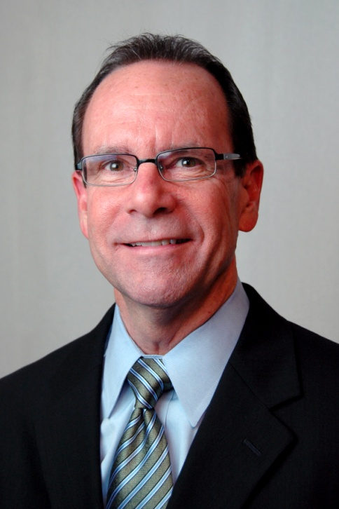
Steve Allen
Stephen L. Allen has more than 25 years experience in Human Resources. Currently the Senior Vice President of HR for North American branch of the engineering and technology company Technip, Mr. Allen is responsible for 3,000 employees worldwide. He holds a Bachelors of Business Administration in Marketing and Communications from the University of Central Oklahoma and an MBA in Organization Effectiveness from the University of Nebraska, as well as PHR and SPHR certifications.

Slide 6
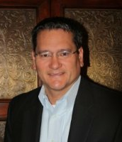
Bill Bradshaw
Bill Bradshaw currently serves as the President of Affinity, a nationwide Oil & Gas Staffing & Recruiting Firm headquartered in Houston, TX. He is responsible for all business operations of the organization. Mr. Bradshaw took over as President of Affinity in June of 2010 and has grown the organization from a small regional staffing firm, to a multi-national executive search firm with locations in TX, LA, WV, and soon CO. Bill holds a BS in Economics from the University of Texas at Austin and currently resides in Northwest Houston with his wife and three children.

Slide 7
Unprecedented Talent Challenge
Well Documented Shortage of Engineers Worldwide
Aging Workforce
Diminishing College Enrollment in N.A.
Simultaneous Boom Cycle Across Multiple Sectors
2010 SBC Oil & Gas HR Benchmark – March 2011
Notes:
The American Petroleum Institute estimates that the avg. age in the oil & gas industry is 51, amongst the oldest of any industry.

Slide 8
Significant Impact on Business
Recruitment Challenges
Staffing Shortages
Project Non-Delivery
Loss of Contracts
$ $$ $$$ $$$$

Slide 9
The Engineering Talent Gap
Percentage of degreed engineers in U.S. (by age)
Source: Society of Petroleum Engineers, Jan. 2010

Slide 10
Q&A Discussions

